Slide 1
Sql for Data Analysis

Slide 2
3. Indexes
A database index is a data structure that improves the speed of data retrieval operations on a database table
An index is a copy of selected columns of data from a table, called a database key
It also includes a low-level disk block address or direct link to the complete row of data it was copied from.
Indexes are used by the Database Search Engine to locate records very fast
Indexes can be created using one or more columns of a database table,
But additional writes and storage space are required to maintain the index structure.

Slide 3
B-Tree & Hash
Indexes are implemented internally using b-trees or hash tables.
HASHTABLE - Access elements by their primary key from a hash table. - Faster than a tree algorithm - But it cannot select ranges
B-TREE - Allows for selecting, sorting and selecting from ranges - It is the default implementation in most cases

Slide 4
Hash index
Text

Slide 5
Text
Each node holds the index value and the pointer to the row it comes from.
Search for the row where id=7, we can quickly find the value 7 in the B-Tree by following the pointer.

Slide 6
Indexes
Create Index along with the table
CREATE TABLE table_name
(
column1 datatype [ NULL | NOT NULL ],
column2 datatype [ NULL | NOT NULL ],
...
column_n datatype [ NULL | NOT NULL ],
INDEX index_name [ USING BTREE | HASH ]
(index_col1 [(length)] [ASC | DESC],
index_col2 [(length)] [ASC | DESC],
...
index_col_n [(length)] [ASC | DESC])
);
Create Table first, then add index on it
CREATE [UNIQUE | FULLTEXT | SPATIAL] INDEX idx_name
[ USING BTREE | HASH ]
ON table_name
(index_col1 [(length)] [ASC | DESC],
index_col2 [(length)] [ASC | DESC],
...
index_col_n [(length)] [ASC | DESC]);
CREATE TABLE contacts ( contact_id INT(11) NOT NULL AUTO_INCREMENT,
last_name VARCHAR(30) NOT NULL,
first_name VARCHAR(25),
birthday DATE,
CONSTRAINT contacts_pk PRIMARY KEY (contact_id),
INDEX contacts_idx (last_name, first_name)
);
CREATE TABLE contacts
( contact_id INT(11) NOT NULL AUTO_INCREMENT,
last_name VARCHAR(30) NOT NULL,
first_name VARCHAR(25),
birthday DATE,
CONSTRAINT contacts_pk PRIMARY KEY (contact_id)
);
CREATE INDEX contacts_idx
ON contacts (last_name, first_name);

Slide 7
Indexing
INDEX refers to a normal non-unique index. - Non-distinct values for the index are allowed, - Don’t enforce any restraints on your data so they are - Used only for making sure certain queries can run quickly.
UNIQUE refers to an index where all rows of the index must be unique. - Non-distinct values for the index are NOT allowed, - Enforce restraints on your data - Ensures that the data is distinct while inserting and updating records
PRIMARY acts exactly like a UNIQUE index, except that it is always named ‘PRIMARY' - There may be only one Primary Key on a table - Is intended to be used as a primary means to uniquely identify any row in the table, - It should not be used on any columns which allow NULL values.
Fulltext indexes are different from all of the above in that it serves a narrow purpose
FULLTEXT indexes are specialised indexes. - Only useful for full text searches done with the MATCH() / AGAINST() clause, - Their behaviour differs significantly between database systems.
Types of Indexes

Slide 8
UNIQUE INDEX
CREATE UNIQUE INDEX index_name ON table_name ( column1, column2,…);
CREATE UNIQUE INDEX author_idx ON fav books (authorid);
INDEXING
DROP INDEX
DROP INDEX index_name;
SINGLE COLUMN INDEX
CREATE INDEX index_name
ON table_name (column1);
COMPOSITE INDEX
CREATE INDEX index_name
ON table_name (column1, column2);
Indexes can be created
or dropped
with no effect on the data.
IMPLICIT INDEXES
Implicit indexes are automatically created by the database server when an object is created.
Indexes are automatically created for primary key constraints and unique constraints.

Slide 9
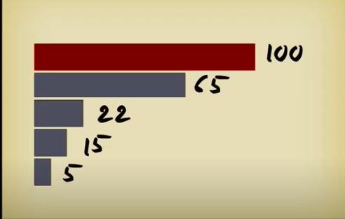
An index helps to speed up SELECT queries and WHERE clauses,
But it slows down data input, using the UPDATE and the INSERT statement
When to use Indexes
- Indexes should be used on large tables.
- Tables that have frequent read operations.
- Columns that are frequently used in WHERE clauses.
When to avoid Indexes
Although indexes are intended to enhance a database's performance, there are times when they should be avoided.
- Indexes should not be used on small tables.
- Tables that have frequent, large batch updates
or insert operations.
- Indexes should not be used on columns that contain
a high number of NULL values.
- Columns that are frequently manipulated should not be indexed.

